Slide 1
IT1322 – Principles of Web Usability Design
Markup Languages II (HTML5)

Slide 2
Recap …
Basic structure of an HTML file
doctype indicates the type of document
1
opening html tag
<!DOCTYPE html>
<html>
<head>
</head>
<body>
</body>
</html>
2
head section contains information about the document
4
5
body section contains content to be displayed in Web browsers
closing html tag
3

Slide 3

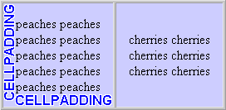
Recap …
HTML Element vs HTML Attribute
Closing element/tag always have a backslash
Starting element/tag without attribute
<h1>Heading 1</h1>
Element content displayed in web browser
Attribute is always added in the starting element tag . Value of attribute is enclosed with double quote or single quote.
<table border="1"> </table>
Empty element closed in the starting tag
<br />
<table cellspacing="5" cellpadding="5“>
</table>
Use <td> to define a table data
Use <th> to define a table header
Use <tr> to define a row. A row of two cells <td>

Slide 4
Recap …
Use lowercase for tag and attribute
All tags must be nested properly and not overlap
Links
<a href=“index.html”>Link text</a>
Named anchor:
<a name=“aboutus”>About Us</a>
<a href=“#aboutus”>Jump to About Us</a>
Heading Elements
<h1>Largest Heading </h1>
<h2> . . . </h2>
<h3> . . . </h3>
<h4> . . . </h4>
<h5> . . . </h5>
<h6>Smallest Heading</h6>
Text Elements
<p>This is a paragraph </p>
<br /> (line break)
<hr /> (horizontal rule)
<!-- This is comment -->
<em>This text is emphasized</em>
<strong>This text is strong</strong>
<b> This text is bold </b>
<i>This text is italic</i>
Tables
<table border=“1” cellpadding=“5” cellspacing=“5”>
<caption>Table Caption</caption>
<tr>
<th>Table Header</th>
<th>Table Header</th>
</tr>
<tr>
<td>Table Data</td>
<td>Table Data</td>
</tr>
</table>
Unordered List
<ul>
<li>Item</li>
<li>Item</li>
</ul>
Ordered List
<ol>
<li>Item 1</li>
<li>Item 2</li>
</ol>

Slide 5
Learning Objectives
Understand the history of World Wide Web
Understand the history of markup languages
Understand the basic elements of markup language tag
Learn how to create a web page and website
Learn how to create interactive web page using emerging markup languages
Part 1
Part 2

Slide 6
HTML Advanced
HTML Layout
  Web page layout is very important to make your website look good
  Multiple columns are created using <table> or <div> tags
  Find out more at http://www.w3schools.com/html/html_layout.asp
HTML Object
  <object> element used to support HTML helpers (plug-ins)
  Can be used to play audio and video
<div id="container" style="width:500px"></div>
<object width="420" height="360"
classid="clsid:02BF25D5-8C17-4B23-BC80-D3488ABDDC6B"
codebase="http://www.apple.com/qtactivex/qtplugin.cab">
<param name="src" value="movie.mp4" />
<param name="controller" value="true" />
</object>

Slide 7

What is HTML5?
HTML5 is the next generation of HTML
Address shortcomings of previous versions of HTML
Not only intended to describe page structure and layout and offers new features:
  The <canvas> element for 2D drawing
  The <video> and <audio> elements for media playback
  Support for local storage
  New content-specific elements, like <article>, <footer>, <header>, <nav>, <section>
  New form controls, like calendar, date, time, email, url, search

Slide 8
HTML5 New Elements
New Structural Elements for better structure
Tag | Description
<article> | Defines an article
<aside> | Defines content aside from the page content
<bdi> | Isolates part of text formatted in different direction from other text
<command> | Defines a command button that a user can invoke
<details> | Defines additional details that user can view or hide
<summary> | Defines a visible headings for <details> element
<figure> | Specifies a self-contained content like illustrations, diagram, etc
<figcaption> | Defines a caption for a <figure> element
<hgroup> | Groups a set of <h1> to <h6> elements
<mark> | Defines a marked/highlighted text
<meter> | Defines a scalar measurement within a known range (gauge)

Slide 9
HTML5 New Elements
New Structural Elements for better structure
New <canvas> Element
Tag | Description
<nav> | Defines a navigation links
<progress> | Represents progress of a task
<ruby> | Defines a ruby annotation
<rt> | Defines an explanation/pronunciation of characters
<rp> | Defines what to show in browsers that do support ruby annotations
<section> | Defines a section in a document
<time> | Defines a date/time
<wbr> | Defines a possible line-break
Tag | Description
<canvas> | Used to draw graphics, on the fly, via scripting (usually JavaScript)

Slide 10
HTML5 New Elements
New Media Elements for media content
New Form Elements
Tag | Description
<audio> | Defines sound content
<video> | Defines a video or movie
<source> | Defines multiple media resources for <video> and <audio>
<embed> | Defines a container for an external application or interactive content (a plug-in)
<track> | Defines text tracks for <video> and <audio>
Tag | Description
<datalist> | Specifies a list of pre-defined options for input controls
<keygen> | Defines a key-pair generator field (for forms)
<output> | Defines the result of a calculation

Slide 11
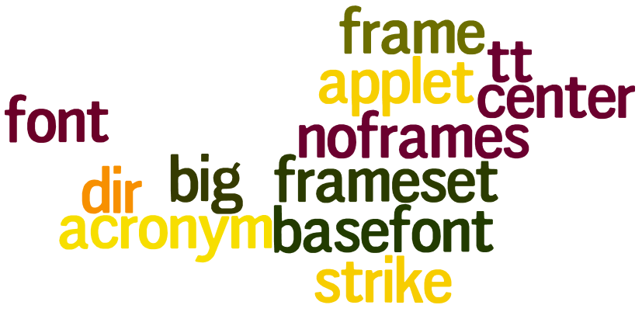
Obsoleted Elements in HTML
All display elements are removed in favor of CSS for presentation
Framesets and frames are removed because of impact on accessibility
Elements that are removed from HTML5
  <acronym>
  <applet>
  <basefont>
  <big>
  <center>
  <dir>
  <font>
  <frame>
  <frameset>
  <noframes>
  <strike>
  <tt>

Slide 12
HTML5 <!DOCTYPE>
Only one <!DOCTYPE> declaration for HTML5
Different DOCTYPE for old HTML
  HTML 4.01 Strict
  HTML 4.01 Transitional
  HTML 4.01 Frameset
<!DOCTYPE html>
<!DOCTYPE HTML PUBLIC "-//W3C//DTD HTML 4.01//EN"
"http://www.w3.org/TR/html4/strict.dtd">
<!DOCTYPE HTML PUBLIC "-//W3C//DTD HTML 4.01 Transitional//EN"
"http://www.w3.org/TR/html4/loose.dtd">
<!DOCTYPE HTML PUBLIC "-//W3C//DTD HTML 4.01 Frameset//EN"
"http://www.w3.org/TR/html4/frameset.dtd">

Slide 13
Minimum HTML5 Document
Simple HTML5 document, with the minimum required tags
<!DOCTYPE html>
<html>
<head>
<title>Title of the document</title>
</head>
<body>
The content of the document......
</body>
</html>

Slide 14
HTML5 Video
<video> element specifies a standard way to embed a video / movie on a web page
Video formats and Browser Support
Tag | Description
<video> | Defines a video or movie
<source> | Defines multiple media resources for media elements, such as <video> and <audio>
<track> | Defines text tracks in mediaplayers
Browser | MP4 | WebM | Ogg
Internet Explorer 9 | ✓ | ✗ | ✗
Firefox 4.0 | ✗ | ✓ | ✓
Google Chrome 6 | ✓ | ✓ | ✓
Apple Safari 5 | ✓ | ✗ | ✗
Opera 10.6 | ✗ | ✓ | ✓

Slide 15
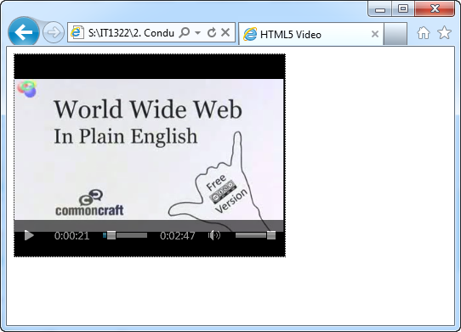
HTML5 Video
<body>
<video width="320" height="240" controls="controls">
<source src="movie.mp4" type="video/mp4" />
<source src="movie.ogg" type="video/ogg" />
Your browser does not support the video tag.
</video>
</body>
Control attribute adds video controls, like play, pause, and volume
Specify width and height attribute, space required for video is reserved when page load
Insert text between the <video> and </video> tags for browsers that do not support <video> element
Allow multiple <source> element that link to different video files, browser will use first recognized format
Notes:
Demo: html5_video.html

Slide 16
HTML5 Audio
<audio> element specifies a standard way to embed an audio file on web page
Audio formats and Browser Support
Tag | Description
<audio> | Defines sound content
<source> | Defines multiple media resources for media elements, such as <video> and <audio>
Browser | MP3 | Wav | Ogg
Internet Explorer 9 | ✓ | ✗ | ✗
Firefox 4.0 | ✗ | ✓ | ✓
Google Chrome 6 | ✓ | ✓ | ✓
Apple Safari 5 | ✓ | ✓ | ✗
Opera 10.6 | ✗ | ✓ | ✓

Slide 17
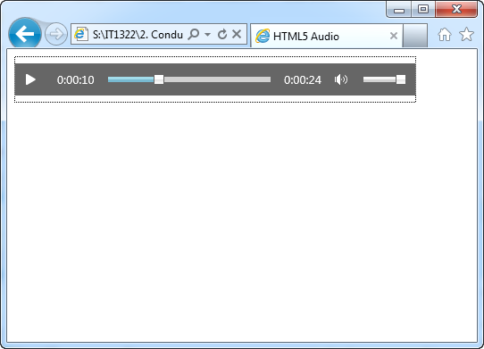
HTML5 Audio
<body>
<audio controls="controls">
<source src="song.mp3" type="audio/mpeg" />
<source src="song.ogg" type="audio/ogg" />
Your browser does not support the audio element.
</audio>
</body>
Control attribute adds audio controls, like play, pause, and volume
Insert text between the <audio> and </audio> tags for browsers that do not support <video> element
Allow multiple <source> element that link to different audio files, browser will use first recognized format
Notes:
Demo: html5_audio.html

Slide 18
HTML5 SVG
SVG stands for Scalable Vector Graphics
  Used to define vector-based graphics for the web
  Defines graphics in XML format
  Do NOT lose any quality if they are zoomed or resized
  Every element and every attribute in SVG files can be animated
Advantages of using SVG over other image format (JPG and GIF)
  Can be created and edited with any text editor
  Can be searched, indexed, scripted, and compressed
  Scalable
  Can be printed with high quality at any resolution
  Zoomable (can be zoomed without degradation)

Slide 19
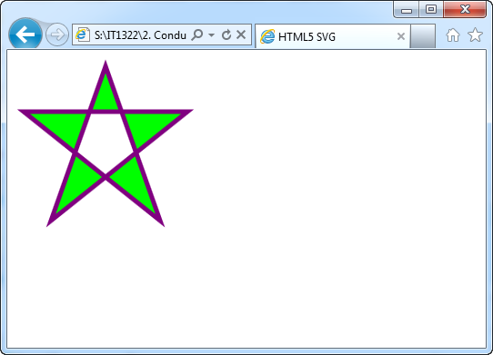
HTML5 SVG
<!DOCTYPE html>
<html>
<head>
<title>HTML5 SVG</title>
</head>
<body>
<svg xmlns="http://www.w3.org/2000/svg" version="1.1" height="190">
<polygon points="100,10 40,180 190,60 10,60 160,180“ style="fill:lime;stroke:purple;stroke-width:5;fill-rule:evenodd;" />
</svg>
</body>
</html>
Notes:
Demo: html5_svg.html

Slide 20
HTML5 Input Types
New input types for forms, new features allow better input control and validation
  color
  - used for input fields that contain color
  date
  - allow users to select a date
  datetime
  - allow user to select date and time (with time zone)
  datetime-local
  - allow user to select date and time (no time zone)
<input type="color" name="favcolor" />
Not all browsers support all the new input types
<input type="date" name="bday" />
<input type="datetime" name="bdaytime" />
<input type="datetime-local" name="bdaytime" />

Slide 21
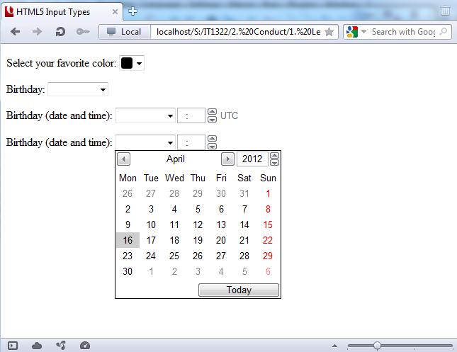
HTML5 Input Types
<body>
<form>
<p>Select your favorite color:
<input type="color" name="favcolor" /></p>
<p>Birthday:
<input type="date" name="bday" /></p>
<p>Birthday (date and time):
<input type="datetime" name="bdaytime" /></p>
<p>Birthday (date and time):
<input type="datetime-local" name="bdaytime" /></p>
</form>
</body>
Notes:
Demo: html5_inputTypes1.html

Slide 22
HTML5 Input Types
  month
  - allow user to select a month and year
  week
  - allow user to select a month and year
  number
  - used for input fields that should contain a numeric value
  - set restrictions on what numbers are accepted
  range
  - used for input fields that should contain a value from a range of numbers
  -set restrictions on what numbers are accepted
<input type="month" name="bdaymonth" />
Select a week: <input type="week" name="weekyear" />
Not all browsers support all the new input types
<input type="number" name="quantity" min="1" max="5" />
<input type="range" name="points" min="1" max="10" />

Slide 23
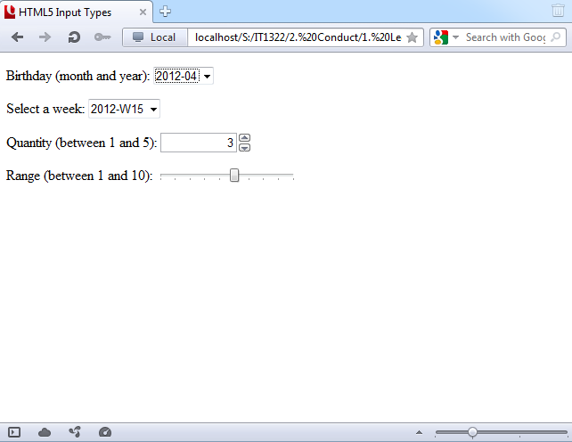
HTML5 Input Types
Demo: http://www.w3schools.com/html/tryit.asp?filename=tryhtml5_input_max_min
max
specifies maximum value allowed
min
specifies minimum value allowed
step
specifies legal number intervals
value
specifies default value
<body>
<form>
<p>Birthday (month and year):
<input type="month" name="bdaymonth" /></p>
<p>Select a week:
<input type="week" name="week_year" /></p>
<p>Quantity (between 1 and 5):
<input type="number" name="quantity" min="1" max="5" /></p>
<p>Range (between 1 and 10):
<input type="range" name="points" min="1" max="10" /></p>
</form>
</body>
Notes:
http://www.w3schools.com/html/tryit.asp?filename=tryhtml5_input_max_min

Slide 24
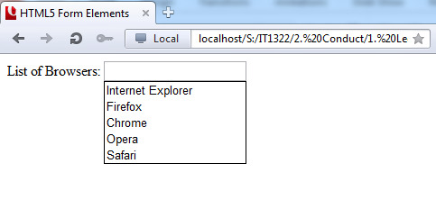
HTML5 Form Elements
HTML5 new Form Elements:
  <datalist> Element
    Specifies a list of pre-defined options for an <input> element
    Used to provide an “autocomplete” feature on <input> elements
    Use <input> element’s list attribute to bind it together with a <datalist> element
Not all browsers support all the new form elements
<body>
<form>
<input list="browsers" />
<datalist id="browsers">
<option value="Internet Explorer">
<option value="Firefox">
<option value="Chrome">
<option value="Opera">
<option value="Safari">
</datalist>
</form>
</body>
Notes:
Demo: html5_form_datalist.html

Slide 25
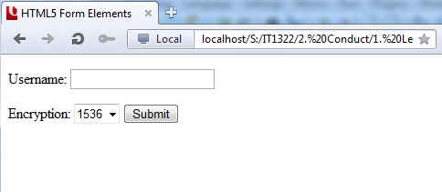
HTML5 Form Elements
HTML5 new Form Elements:
  <keygen> Element
    Used to provide a secure way to authenticate users
    Specifies a key-pair generator field in a form
    When form submit, two keys are generated (one private and one public)
Not all browsers support all the new form elements
<body>
<form>
<p>Username: <input type="text" name="usr_name" /> </p>
<p>Encryption: <keygen name="security" />
<input type="submit" /></p>
</form>
</body>
Notes:
Demo: html5_form_keygen.html

Slide 26
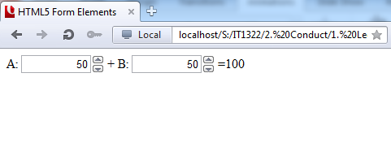
HTML5 Form Elements
HTML5 new Form Elements:
  <output> Element
    Represents result of a calculation (like performed by script)
    Perform calculation and show result in an <output> element
Not all browsers support all the new form elements
<body>
<form oninput="x.value=parseInt(a.value)+parseInt(b.value)">
A: <input type="number" name="a" value="50" />
+ B: <input type="number" name="b" value="50" />
= <output name="x" for="a b"></output>
</form>
</body>
Notes:
Demo: html5_form_output.html

Slide 27
HTML5 Form Attributes
New attributes for <form>:
  autocomplete
  novalidate
Not all browsers support all the new form atrributes
New attribute for <input>:
  autocomplete
  autofocus
  form
  formaction
  formenctype
  formmethod
  formnovalidate
  formtarget
  height and width
  list
  min and max
  multiple
  pattern (regexp)
  placeholder
  required
  step
http://www.w3schools.com/html5/html5_form_attributes.asp

Slide 28
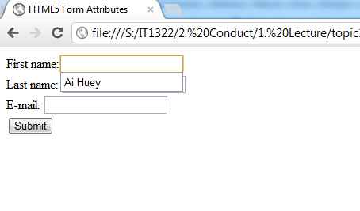
HTML5 Form Attributes
Not all browsers support all the new form atrributes
<form>/<input> autocomplete Attribute
  Specifies whether a form or input field should have autocomplete on or off
  When autocomplete is on, the browser automatically based on values that the user has entered before
<body>
<form autocomplete="on">
First name:<input type="text" name="fname" /><br />
Last name: <input type="text" name="lname" /><br />
E-mail: <input type="email" name="email" autocomplete="off" />
<br />
<input type="submit" />
</form>
</body>
Turn off for specific input field
http://www.w3schools.com/html/tryit.asp?filename=tryhtml5_input_autocomplete
Notes:
Demo: html5_form_autocomplete.html

Slide 29
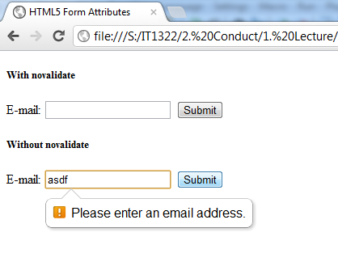
HTML5 Form Attributes
Not all browsers support all the new form atrributes
<form> novalidate Attribute
  When present → form-data (input) should not be validated when submitted
<body>
<form novalidate>
E-mail: <input type="email" name="email" />
<input type="submit" />
</form>
</body>
DEMO: http://www.w3schools.com/html/tryit.asp?filename=tryhtml5_input_formnovalidate
Notes:
Demo: html5_form_novalidate.html

Slide 30
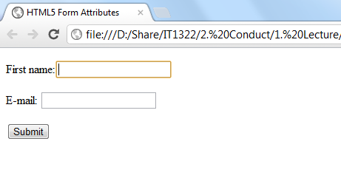
HTML5 Form Attributes
Not all browsers support all the new form atrributes
<input> autofocus Attribute
  When present → specifies <input> element should be automatically get focus when page loads
<body>
<form>
<p>First name:<input type="text" name="fname" autofocus /></p>
<p>E-mail: <input type="email" name="user_email" /></p>
<input type="submit" />
</form>
</body>
http://www.w3schools.com/html/tryit.asp?filename=tryhtml5_input_autofocus
Notes:
Demo: html5_form_autofocus.html

Slide 31
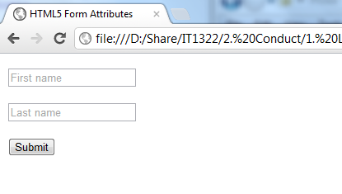
HTML5 Form Attributes
Not all browsers support all the new form atrributes
<input> placeholder Attribute
  Specifies a short hint that describes the expected value of an input field
<body>
<form>
<p><input type="text" name="fname" placeholder="First name" /></p>
<p><input type="text" name="lname" placeholder="Last name" /></p>
<input type="submit" value="Submit" />
</form>
</body>
http://www.w3schools.com/html/tryit.asp?filename=tryhtml5_input_placeholder
Notes:
Demo: html5_form_placeholder.html

Slide 32
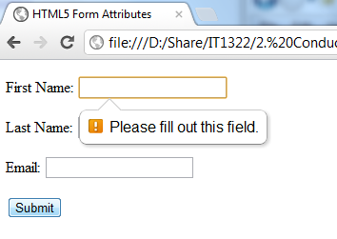
HTML5 Form Attributes
Not all browsers support all the new form atrributes
<input> required Attribute
  When present → Specifies that an input must be filled before submitting the form
<body>
<form>
<p>First Name: <input type="text" name="fname" required /></p>
<p>Last Name: <input type="text" name="lname" required /></p>
<p>Email: <input type="text" name="email" /></p>
<input type="submit" value="Submit" />
</form>
</body>
DEMO: http://www.w3schools.com/html/tryit.asp?filename=tryhtml5_input_required
Notes:
Demo: html5_form_required.html

Slide 33
HTML5 Structural Elements
Structural elements in HTML 4.01 for page layout
<div id=“header”>
<div id=“nav”>
<div id=“section”>
<div id=“aside”>
<div id=“article”>
<div id=“footer”>

Slide 34
HTML5 Structural Elements
Structural elements in HTML5 for page layout
<header>
<nav>
<section>
<aside>
<article>
<footer>

Slide 35
HTML5 Structural Elements
To mark the page header, use the <header> element
To mark the page footer, use the <footer> element
To mark a main section of page content, use the <section> element
To mark a sidebar, use the <aside> element
To mark an article, use the <article> element
Element | Description
<article> | A subsection covering a single topic
<aside> | Content containing side issues to the main topic of the page
<footer> | Content placed at the bottom of the page
<header> | Content placed at the top of the page
<nav> | A navigation list of hypertext links
<section> | A major topical area of the page

Slide 36
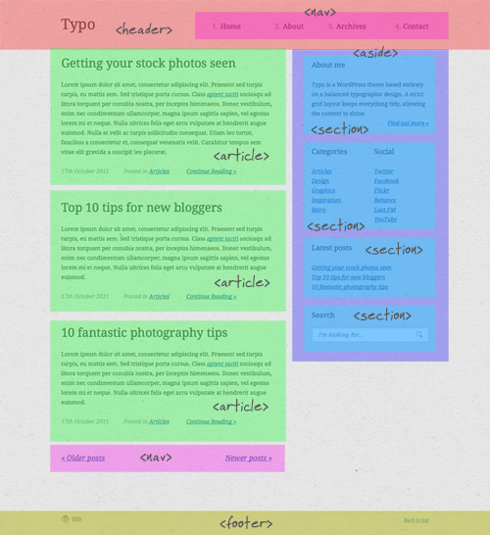
HTML5 Structural Elements
http://line25.com/tutorials/create-a-typography-based-blog-layout-in-html5

Slide 37
Advanced HTML5
Many other HTML5 features:
  HTML5 Drag and Drop
  HTML5 Canvas
  HTML5 Geolocation
  HTML5 Web Storage
  HTML5 App Cache
  HTML5 Web Workers
  HTML5 Server-Sent Events

Slide 38
Create Syntactically Correct Code
Document must be well-formed
A well-formed document is one that adheres to the syntax rules below:
  All tags must nest properly and not overlap
  Use all lowercase for element names
  Always use closing tags
  Empty elements are marked with a closing slash
  Attributes values must be contained in quotation marks
<p><strong> Some text … </p></strong> ✗
<p><strong> Some text … </strong></p> ✓
<p><STRONG> Some text … </STRONG></p> ✗
<p><strong> Some text … </strong></p> ✓
<p>Some text … ✗
<p>Some text … </p> ✓
<img src=“photo.jpg” > <br> ✗
<img src=“photo.jpg” /> <br /> ✓
<img src=photo.jpg /> ✗
<img src=“photo.jpg” /> or <img src=‘photo.jpg’ /> ✓

Slide 39
Summary
Key features
  New markup and layout elements
  The <video>, <audio>, and <canvas> elements
  Revised elements based on HTML 4.0
An overview of HTML5 APIs and supporting technologies
Simpler <!DOCTYPE> declaration for HTML5
New structural elements for better page structure
  <header>, <footer>, <nav>, <aside>, <section>, <article>

